Slide 1
Table of Contents
Tools And Stack
Eureka
Consul
Zookeeper
Comparisons
Spring Cloud Netflix
Notes:
Diagram Examples: General
General > App Engine and Cloud Endpoints
General > Compute Engine and REST or gRPC
General > Content Management
General > Digital Asset Management and Sharing
General > Firebase and Google App Engine
General > Firebase and Managed VMs
General > Firebase
General > GitLabCIonGKE
General > Hadoop on Google Cloud Platform
General > High Performance Computing
General > Real Time Bidding
General > Real Time Stream Processing IoT
General > Web Application on Google App Engine
Diagram Examples: Specific
Media > Hybrid Rendering
Media > Live Streaming
Media > Rendering
Media > Transcoding
Gaming > Backend Database
Gaming > Gaming Analytics
Gaming > Mobile Game Backend
Gaming > Real-Time AAA Games Servers
Digital Marketing > DMP Data Warehouse
Digital Marketing > Publisher side analysis
Digital Marketing > Real-Time Bidding
Internet of Things > MQTT to PubSub Broker
Internet of Things > Sensor stream ingest and processing
Financial Services > Monte Carlo Simulations
Financial Services > Time Series Analysis
Dev Test > Continuous Delivery with Spinnaker
Dev Test > Jenkins on k8s
Dev Test > Scale Testing with Kubernetes+Locust
Dev Test > UI Testing with Kubernetes
Backup and Archive > DR Cold standby server
Backup and Archive > DR Warm static site
Backup and Archive > DR with Application Replication
Backup and Archive > Hosting Filers
Websites > API Hosting
Websites > Content Hosting
Websites > Dynamic Hosting
Websites > Mobile Site Hosting
Websites > Static Hosting
Mobile > Mobile Game Backend
LifeSciences > Genomics, Secondary Analysis
LifeSciences > Patient Monitoring
LifeSciences > Variant Analysis
Retail > Beacons and Targeted Marketing
Retail > Fraud Detection
Retail > PCI
Retail > Real-Time Inventory
Retail > Recommendation Engines
Retail > Shopping Cart Analysis
Big Data > Complex Event Processing
Big Data > DMP Data Warehouse
Big Data > Log Processing
Big Data > Time Series Analysis

Slide 2
Registration & Discovery Tools
Eureka
基于REST 的服务，服务注册发现中心
Netflix技术栈 Spring Cloud集成方便
解决中间业务层的负载均衡和Failover (Eureka Client 端)
有简单的Web UI可以查看注册的服务
配合Netfix的技术栈可以实现熔断
Consul
基于REST 的服务，服务注册发现中心
Netflix技术栈 Spring Cloud集成方便
解决中间业务层的负载均衡
有简单的Web UI可以查看注册的服务
配合Netfix的技术栈可以实现熔断

Slide 3
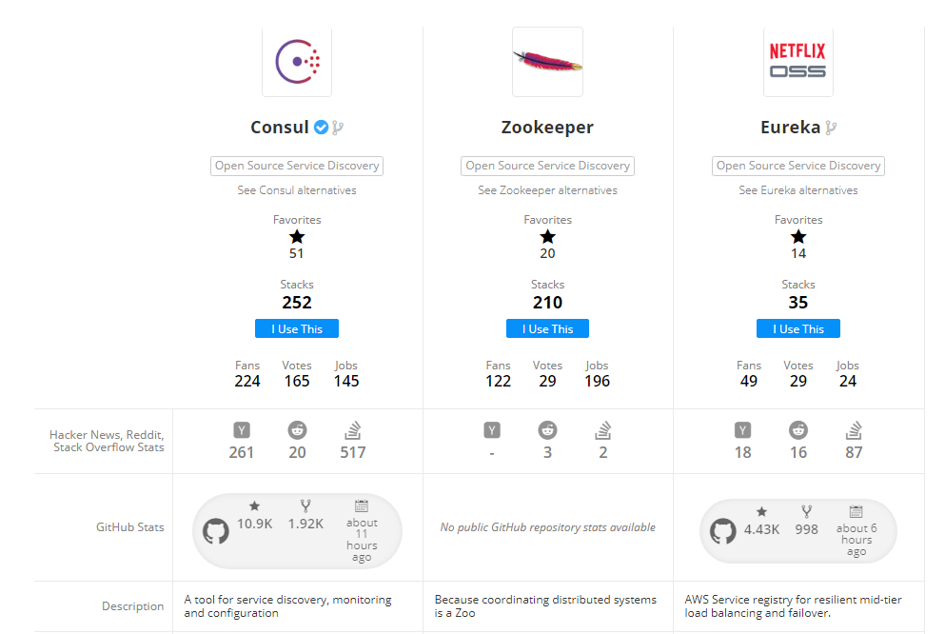
Comparisons
Notes:
https://stackshare.io/stackups/consul-vs-eureka-vs-zookeeper

Slide 4
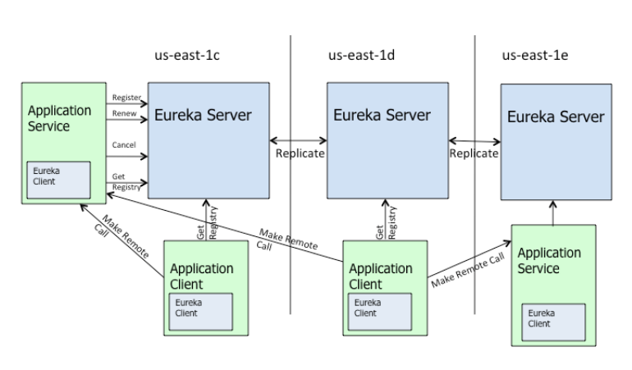
Eureka

Slide 5
Spring Cloud Netflix > Registering with Eureka
版本：Spring Boot 1.5.9.RELEASE Spring Cloud: Edgware.RELEASE
术语：
Eureka Instance / Client - 注册在eureka server 上的微服务 或者消费者
微服务的注册 (基本保持默认配置)
配置eureka服务器地址（application配置）： eureka.client.serviceUrl.defaultZone=http://localhost:8761/eureka/
Status Page和Health Indicator必须返回200； （ 引入Spring Boot Actuator将自动添加这两个Endpooints ）默认情况下服务的在eureka中的状态是有服务主动发起的心跳来更新。 Eureka的Health Check
HTTP 而非 HTTPS （默认HTTP）
微服务的消亡
当一个服务注册后，默认每30秒会向Eureka发一次心跳告知本服务目前是UP状态。 当超过一定时间Eureka Sever没有接收到心跳，Eureka Server 就会移除这个服务。
测试情况： shutdown一个服务后，2分钟会从Eureka中移除
Notes:
https://cloud.spring.io/spring-cloud-netflix/multi/multi_spring-cloud-eureka-server.html#spring-cloud-eureka-server-zones-and-regions

Slide 6
Spring Cloud Netflix > High Availability, Zones and Regions
单机模式
Eureka对服务的instance的信息的缓存分别在Client端和Eureka Server端都有（缓存于内存中）。所以一般情况下单机模式已经足够。对于生产环境，如果配备相关监控加弹性运行时（比如Cloud Foundry）。
注意事项：关闭客户端的注册行为。
eureka:
client:
registerWithEureka: false # 默认是true，集群的时候需要保持默认
fetchRegistry: false # 默认是true， 集群的时候需要保持默认
Notes:
https://cloud.spring.io/spring-cloud-netflix/multi/multi_spring-cloud-eureka-server.html#spring-cloud-eureka-server-zones-and-regions

Slide 7
Spring Cloud Netflix > High Availability, Zones and Regions
集群模式
集群的时候，只需要彼此互相注册。
Eureka默认是通过hostname来访问的，需要确保hostname的正确性，一般可以不加配置，程序会通过java.net.InetAddress来获取到hostname。如果需要修改采用IP 访问可以参考配置文档： http://cloud.spring.io/spring-cloud-static/spring-cloud.html#_spring_cloud_netflix
---
spring:
profiles: peer1
eureka:
instance:
hostname: peer1
client:
serviceUrl:
defaultZone: http://peer2/eureka/
---
spring:
profiles: peer2
eureka:
instance:
hostname: peer2
client:
serviceUrl:
defaultZone: http://peer1/eureka/
Notes:
http://cloud.spring.io/spring-cloud-static/spring-cloud.html#_spring_cloud_netflix

Slide 8
规范
Eureka Server 规范
使用Standalone模式
关闭客户端行为，即：关闭自注册行为： eureka.client.registerWithEureka=false eureka.client.fetchRegistry=false
根据服务的多少合理设置renewalPercentThreshold （这里面存在一个问题：微服务的特性可能导致不同服务的示例有很大的却别，但是这个设置是针对所有的示例的）
Spring-Boot 微服务接入规范
使用和Eureka Server同样的Spring Cloud 版本
Status Page和Health Indicator必须返回200
配置只需要指定Eureka Server的URL，其他采用默认配置。
Notes:
https://cloud.spring.io/spring-cloud-netflix/multi/multi_spring-cloud-eureka-server.html#spring-cloud-eureka-server-zones-and-regions

Slide 9
示例代码和 参考资源
示例代码：
https://github.com/choelea/spring-cloud-nodejs
参考资源：
https://cloud.spring.io/spring-cloud-netflix/multi/multi_spring-cloud-eureka-server.html#spring-cloud-eureka-server-zones-and-regions
https://cloud.spring.io/spring-cloud-netflix/multi/multi_spring-cloud-eureka-server.html#spring-cloud-eureka-server-zones-and-regions
http://cloud.spring.io/spring-cloud-static/spring-cloud.html#_spring_cloud_netflix
https://github.com/spring-cloud/spring-cloud-netflix/issues/203
http://www.itmuch.com/spring-cloud-sum-eureka/
https://blog.asarkar.org/technical/netflix-eureka/ 弥补Spring Cloud 和Eureka之间的文档不足
https://github.com/Netflix/eureka/wiki/Understanding-Eureka-Peer-to-Peer-Communication
Notes:
https://cloud.spring.io/spring-cloud-netflix/multi/multi_spring-cloud-eureka-server.html#spring-cloud-eureka-server-zones-and-regions

Slide 10
关于Eureka 集群以及自我保护模式的问题
Eureka的自我保护模式会导致Eureka Client获取到已经不存在的Instance。
Notes:
https://cloud.spring.io/spring-cloud-netflix/multi/multi_spring-cloud-eureka-server.html#spring-cloud-eureka-server-zones-and-regions

